Slide 1

Sports fan?
It’s a results-based business.

Slide 2



Okay, so…
What is a player worth?
Can we determine value from performance?
Who is overperforming?
Who is underperforming?

Slide 3


Who is interested in these models?
Management
Agents
Players
Media
Fans

Slide 4

Peeling back the curtain…

Slide 5
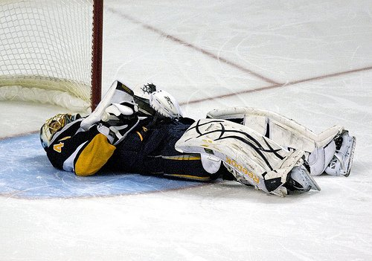

What we did:
X = Performance metrics from NaturalStatTrick.com
y = Salary data from CapFriendly.com
Leveraged machine learning!
y = Xw
3 models:
Centers
Wingers
Defence
Sorry Goalies!

Slide 6

Because you’ll ask…
Normalized our target labels with respect to the salary cap
y = Cap Hit / Salary Cap
Leveraged both standard and advanced performance metrics in a per game format
Goals/GP
Assists/GP
XGF/GP
…
Trained using XGB Regression
Recursive feature elimination
Cross validation
Grid search for parameter tuning

Slide 7
The product
Web-based interactive interface
Search by team / player
2007-08 → 2023-24
Compare model prediction to actual value + a whole lot more!

